Slide 1
Satisfactory Progress Presentation
Bradley Smith - up2178845

Slide 2
Project Description - Aims and Objectives
My project is classifying bird species based on audio files of their calls with deep learning techniques.
Initial Aim: create a model to classify over 100 species with an F1 score of at least 0.7, or classify up to 100 species with an F1 score of at least 0.9.
Updated Aim: create a model to classify at least 50 species of bird with an F1 score of at least 0.7.

Slide 3
Dataset Description
The dataset I am using is a combination of 5 Kaggle competition datasets titled “BirdCLEF” (plus an extra “Birdsong Recognition” dataset) hosted yearly by the Cornell Lab of Ornithology.
https://www.kaggle.com/organizations/cornelllabofornithology/competitions
After combining and removing duplicate files, the total dataset size is 57.6GB, containing a total of 992 folders, and 112,861 audio files in .ogg and .mp3 format.
Dataset | Size (GB)
Birdsong Recognition (2020) | 23.6
BirdCLEF-2021 | 39.2
BirdCLEF-2022 | 6.2
BirdCLEF-2023 | 5.0
BirdCLEF-2024 | 7.3

Slide 4
Existing Literature
Gairí, P., Pallejà, T., Tresanchez, M., 2025 - Environmental sound recognition on embedded devices using deep learning: a review
Examines multiple types of deep learning approaches on low computational complexity devices for classification of audio recordings. Compares output class counts, approaches taken, preprocessing steps, etc. Highest output class count is 200 classes (Choudhary et al, 2022).
Kareem, N. A., Rajan, R., 2023 - Multi-Label Bird Species Classification Using Sequential Aggregation Strategy From Audio Recordings
Investigates and applies numerous models and approaches in a multi-label classification setting of bird call audio files, which is applicable to single-label classification. It covers topics such as sequential aggregation and mel-frequency spectrograms while experimenting with transfer learning on existing models such as CNNs, LSTMs and DNNs.

Slide 5
Methodology to Achieving Final Aim
For my final model, I will likely use a form of convolutional neural network, and apply it to mel-spectrograms of the audio recordings.
I will need to:
Transform the audio data into mel-spectrogram sound clips for analysis.
Create consistency in model loading/training to ensure model predictive accuracy is not due to random chance.
Investigate post-model application techniques to improve accuracy on a per-file basis.
Investigate other model types via transfer learning to determine the most suitable model.

Slide 6
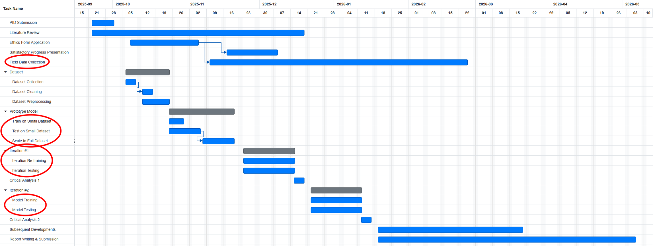
Development Timeline - Initial Gantt Chart

Slide 7
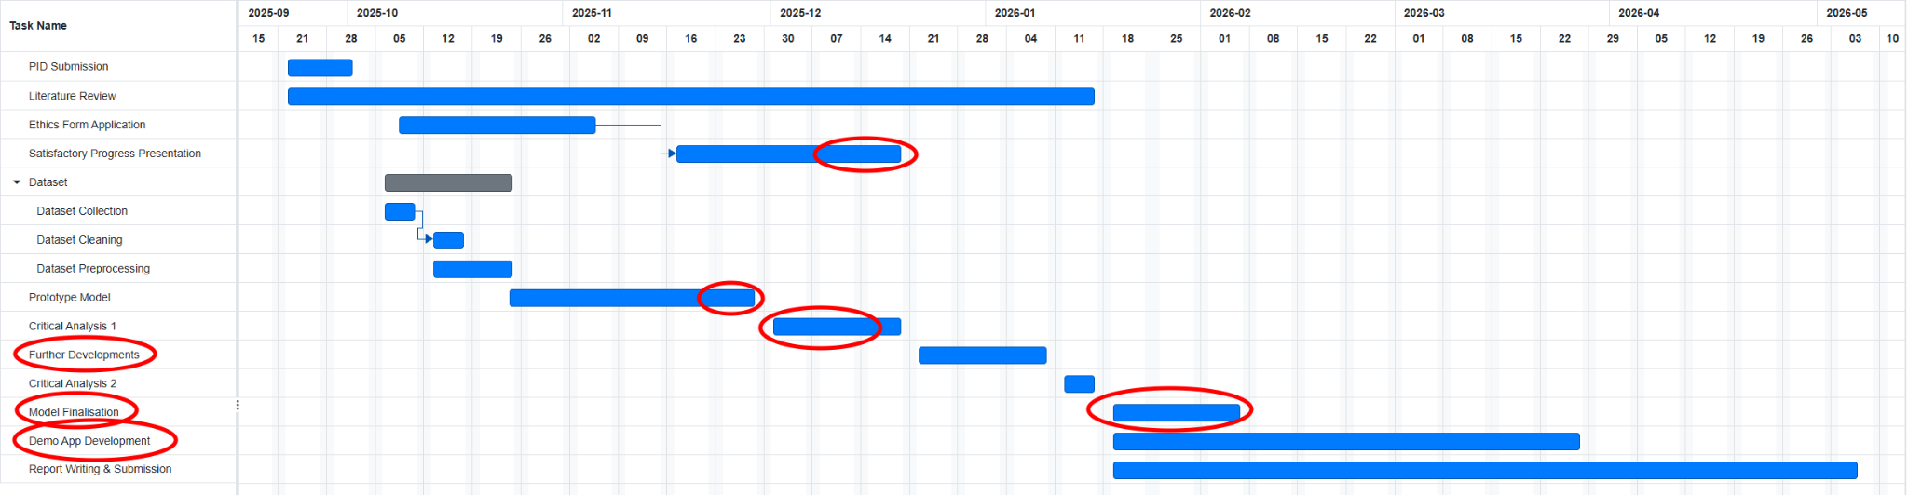
Development Timeline - Updated Gantt Chart

Slide 8
Current Standing: What I Have and What Needs Doing
What I have:
A simple CNN with 30% accuracy (50% top 5 accuracy) over 50 species with 2 second sound clips.
Results with hyperparameter tuning, including learning rates, momentum/weight decay, dropout regularisation, batch training, random over/under/median sampling techniques, audio file splitting.
Optimised code for minimising memory, CPU and GPU core usage, while maximising model capabilities.
Model accountability for variable input shapes (to save time hard-coding figures after flattening, CNN layer output size, etc.)
What needs doing:
Proper write-up of literature review. Complete by mid-January at the latest. Continue to investigate papers after.
Deeper preprocessing exploration, analysis of class and file size distribution, identifying and/or removing “ambient noise” from sound.
Experimentation of different models (Transfer Learning, LSTM/RNN, DNN, etc.)
Experimentation of file splits and their effects. Sequential aggregation + analysing full files vs smaller splits.
Calculation of statistical metrics (F1 score, precision, recall, macro-averaging)
Development of a prototype app to visually showcase the capabilities of the final model.

Slide 9
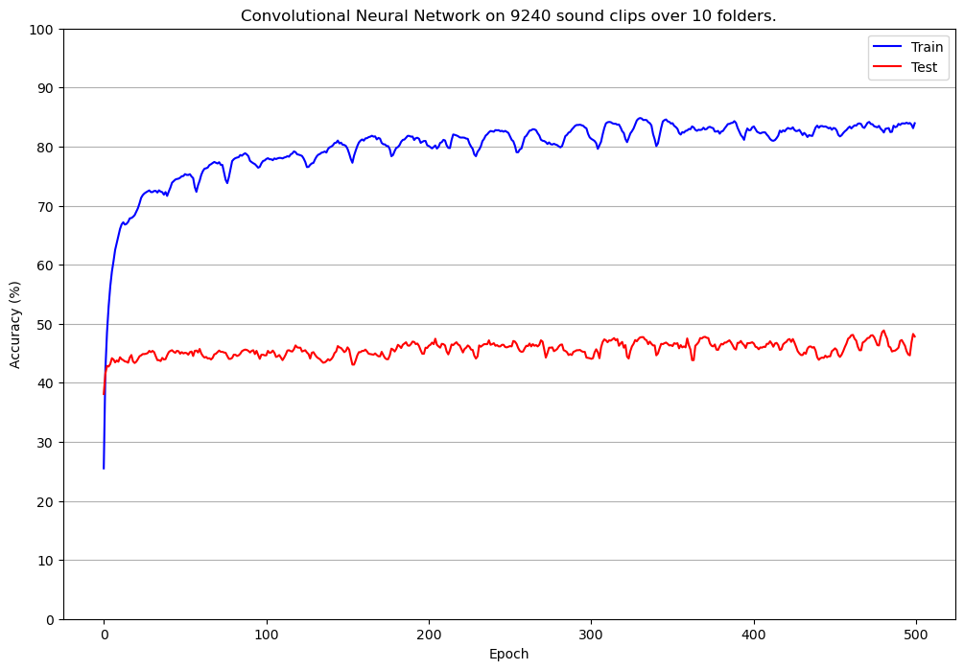
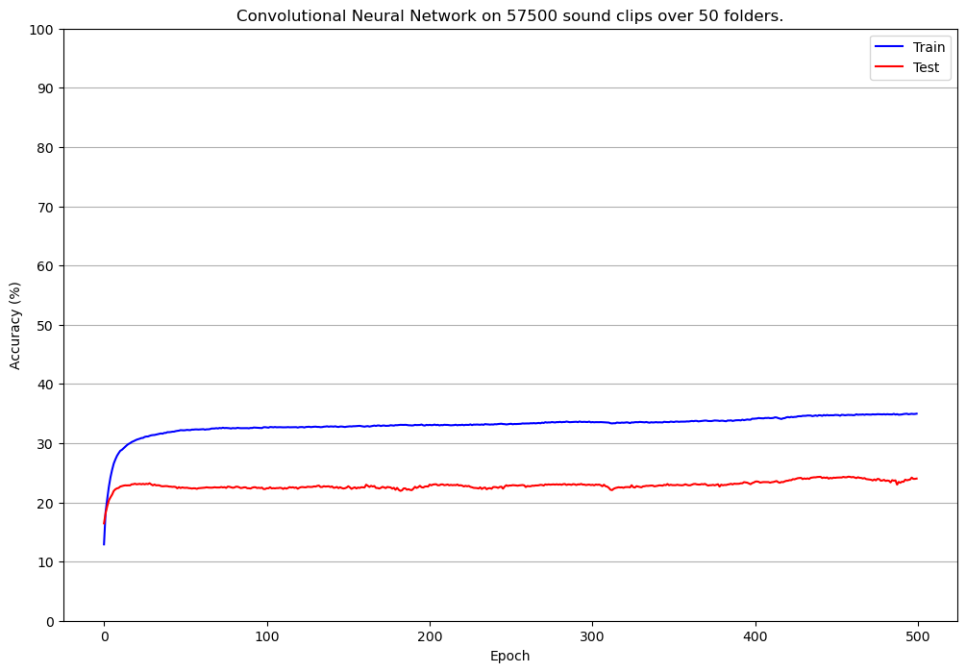
Sample Model Training Outputs

